Slide 1
DS-306 Data Warehousing and Business Intelligence
Topic 7: ETL Fundamentals
Dr. Khurram Shahzad
https://www.youtube.com/watch?v=0ikNnenDyNw

Slide 2
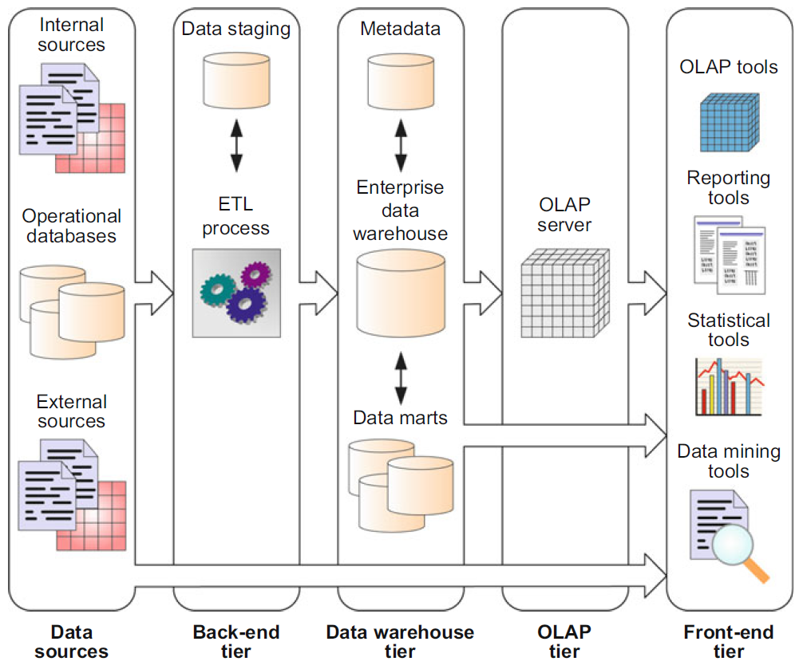
Typical DW architecture

Slide 3
Typical DW architecture

Slide 4
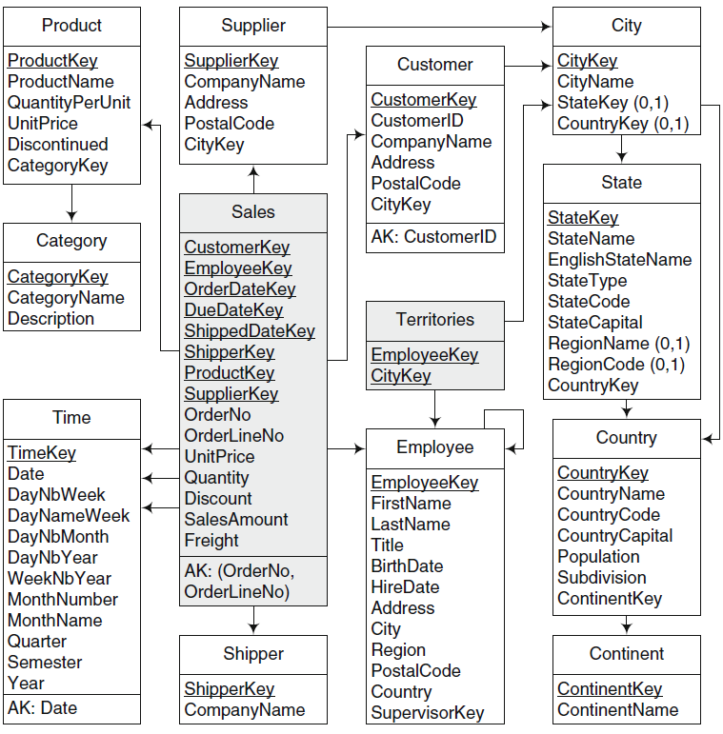

Slide 5
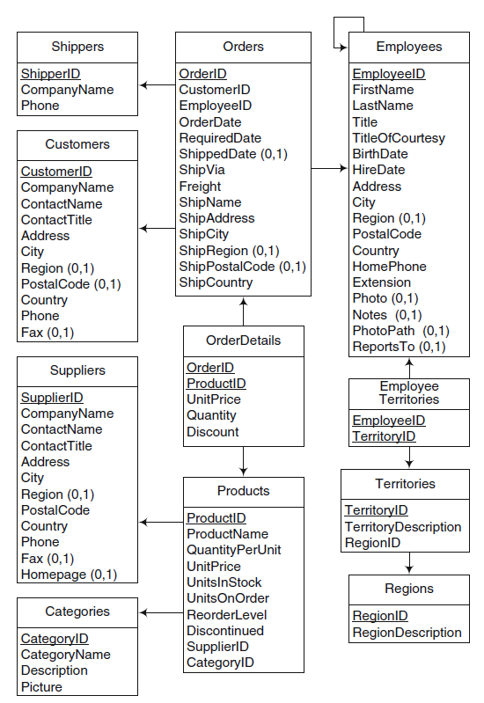

1
5
2
4
3
2
3
4
5
1

Slide 6
Table level mapping

Slide 7
Shipper - Shipper
Shipper
ShipperID
CompanyName
Shipper
ShipperKey
CompanyName

Slide 8
Customer - Customer
Customer
CustomerID
CompanyName
ContactNAme
ContactTitle
Address
City
Region
PostCode
Country
Phone
Fax
Customer
CustomerKey
CustomerID
CompanyName
Address
PostalCode
CityKey

Slide 9
Customer - Customer
Customer
CustomerKey
CustomerID
CompanyName
Address
PostalCode
CityKey
City
CityKey
CityName
StateKey
CountryKey
Customer
CustomerID
CompanyName
ContactNAme
ContactTitle
Address
City
Region
PostCode
Country
Phone
Fax
State
StateKey
StateName
EnglishStateName
StateCode
StateCapital
RegionName
CountryKey

Slide 10
Supplier - Supplier
Supplier
SupplierKey
CompanyName
Address
PostalCode
CityKey
City
CityKey
CityName
StateKey
CountryKey
Suppliers
SupplierID
CompanyName
ContactNAme
ContactTitle
Address
City
Region
PostCode
Country
Phone
Fax
State
StateKey
StateName
EnglishStateName
StateCode
StateCapital
RegionName
CountryKey

Slide 11
Fact Table
Sales
CustomerKey
EmployeeKey
OrderDateKey
Duedatekey
Shippeddatekey
Shipperkey
OrderNo
OrderLine No
UnitPrice
Quantity
Discount
SalesAmount
Freight

Slide 12
ETL function
Re-shape relevant data from source systems into useful information for DW.
Is a combination of
  Extraction
  Transformation
  Loading
Most important and challenging
  Because of the diverse and heterogeneous nature of source systems
  Up to 80% of the total effort of BI implementation

Slide 13
Why ETL is challenging?
Reasons
  Source systems are diverse and disparate
  Source systems are on multiple platforms, different operating systems
  Many sources are older legacy applications on obsolete database technologies
  Typically, historical data changes are not preserved in sources
  Dubious data quality
  Sources keep changing overtime

Slide 14
ETL function
Reasons (cont.)
  Gross lack of consistency among sources systems in common
    Same data is presented differently in various systems
  Lack of means to resolving mismatches escalates the issue
  Source systems may not represent data in types or formats that are meaningful (unclear attributes)

Slide 15
CMS Case Study

Slide 16
Analytical Questions
What is the average CGPA of Class?
What is the average marks given by a Regular Faculty and Visiting Faculty?
What is the grades comparison of faculty with respect to course load?
What is the average grades if semester Calendar is of 14 weeks vs 16 weeks?

Slide 17
The ETL Cycle
EXTRACT
The process of reading data from different sources.
TRANSFORM
The process of transforming the extracted data from its original state into a consistent state so that it can be placed into another database.
LOAD
The process of writing the data into the target source.

MIS Systems
(Acct, HR)
TRANSFORM
CLEANSE
Data Warehouse
www data
Legacy
Systems
EXTRACT
LOAD
Archived data

Other indigenous applications
(COBOL, VB, C++, Java)
OLAP
Temporary
Data storage

Slide 18
Typical DW architecture

Slide 19
Data Stagging, Staging area, landing zone
An intermediate storage area used for raw data
Between data source (OLTP) and data target (DW)
Temporary storage
Implementation
  Various formats, relational databases, JSON, XML format, spread sheets, etc.
  Not in Star format
Can be in more than one format

Slide 20
Reasons for Data Stagging
Reasons
  Data consolidation
  Enhanced data quality
  Schema alignment
  Data Integration
  Performance efficiency
  Data Security
    Compliance with privacy and security protocols
  Audit and tracking
    Comparing input and the output files

Slide 21
ETL
Extraction
Transformation
Loading

Slide 22
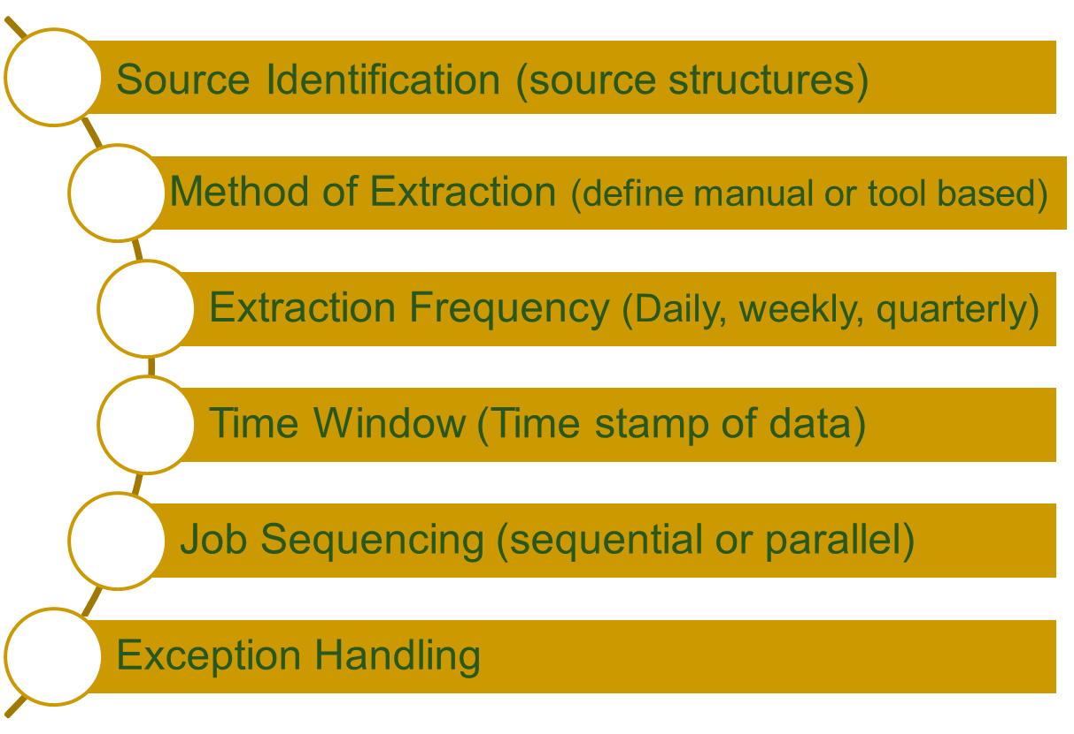
Data Extraction High-level Issues

Slide 23
Data Acquisition (specific issues)
Diversity in source systems and platforms
  Dozens of source systems across organizations
  Numerous systems within an organization
  Need specialist for each
Platform | OS | DBMS | MIS/ERP
Main Frame | VMS | Oracle | SAP
Mini Computer | Unix | Informix | PeopleSoft
Desktop | Win NT | Access | JD Edwards
 | DOS | Text file

Slide 24
Data Acquisition (specific issues)
Same data, different representation
Date value representations
Examples:
970314 1997-03-14
03/14/1997 14-MAR-1997
March 14 1997 2450521.5 (Julian date format)
Gender value representations
Examples:
- Male/Female - M/F
- 0/1 - PM/PF

Slide 25
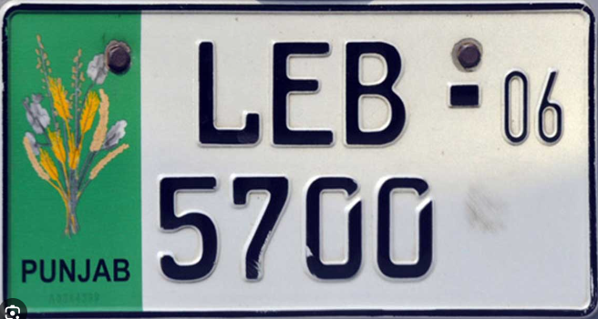

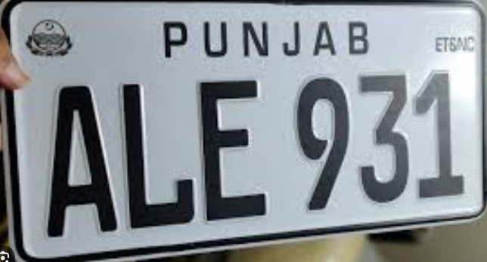


Data Acquisition (specific issues)
  Car number plats

Slide 26
Data Acquisition (specific issues)
Multiple sources for the same data elements
  Need to establish precedence between source systems on a per data element basis.
  Take data element from source system with highest precedence where element exists
  Must sometimes establish “group precedence” rules to maintain data integrity
  Guessing gender from name
  First, middle and family name from two systems of different rank. People using middle name as first name

Slide 27
Data Acquisition (specific issues)
Rigidity and unavailability of legacy systems
  Need efficient and easy ways to deal with incompatible formats
  Need specialized / outdated skills
  Absence of metadata or documentation of systems

Slide 28
Data Acquisition (specific issues)
Volume of legacy data
  Talking about not weekly data, but data spread over years
  Historical data on tapes that are serial and very slow to mount etc.
  Need lots of processing and I/O to effectively handle large data volumes.
  Need efficient interconnect bandwidth to transfer large amounts of data from legacy sources to DWH.

Slide 29
Data Acquisition (specific issues)
Web scrapping
  Lot of data in a web page but mixed with junk
  Problems
    Limited query interfaces
    Free text fields
    Rapid changes without notice

Slide 30
Types of Data Extraction
Logical Extraction
  Full Extraction
  Incremental Extraction
Physical Extraction
  Online Extraction
  Offline Extraction
  Legacy vs. OLTP

Slide 31
Logical data extraction
Full Extraction
  The data extracted completely from the source
  No need to keep track of changes.
  Source data made available as-is with any additional information
Incremental Extraction
  Data extracted after a well-defined point/event
  Mechanism used to reflect/record the temporal changes in data

Slide 32
Physical data extraction
Online Extraction
  Data extracted directly from the source system
  May access source tables through an intermediate system
  Intermediate system usually similar to the source system

Slide 33
Physical data extraction
Offline Extraction
  Data NOT extracted directly from the source system, instead staged explicitly outside the original source system.
  Data is either already structured or was created by an extraction routine.
  Some of the prevalent structures are:
    Flat files
    Dump files
    Redo and archive logs

Slide 34
ETL
Extraction
Transformation
Loading

Slide 35
Where Transformation is required?
Where is Data Transformation required?
  Migrate legacy systems to modern applications
  Translate from one data model to another
  Integrate heterogeneous systems
  Achieve enterprise-wide integration

Slide 36
1. Data Transformation (Basic Tasks)
Basic transformation: basic tasks
  Selection (part of Source)
  Decoding of fields
  Splitting/joining of fields
  Conversion (like date format, units)
  Summarization (aggregates)
  Enrichment (adding new data or modifying existing data)

Slide 37
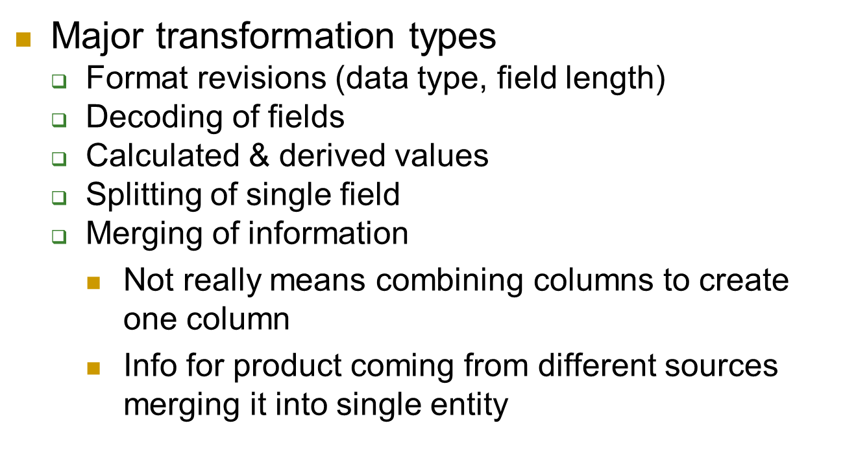
2. Major Transformation Types

Slide 38
2. Major Transformation Types
  Conversion of units of measurements
    For companies with global branches Km vs. mile or lb vs Kg
  Data and time conversion
    June 4, 2005 as 6/4/2005 in US and 4/6/2005 in the British format.
    This date may be standardized to be written as 14 NOV 2005.
  Key restricting
  Duplication

Slide 39
2. Major Transformation Types
  Key restricting
    92424979234 changed to 12345678
    +92-334-4633353, 00923344633353, PK(+92)-(0)334-
  ****92**334*4633353
  +92-334-4633353,
  00923344633353,
  PK(+92)-(0)334-4633353
92 | 42 | 4979 | 234
Country_Code | City_Code | Post_Code | Product_Code

Slide 40
3. Data Transformation (integration)
Data integration and consolidation (major challenges)
  Entity identification problem
  Multiple sources problem
  Transformation for dimension attributes
  How to implement transformation
    Using transformation tools
    Using manual techniques
BSDSF21A011 Fatima Khurram
MSDSF26M001 Fatima Hassan

Slide 41
Data Transformation Tasks: Example-1
Convert common data elements into a consistent form i.e. name and address.
Translation of dissimilar codes into a standard code.
Field format Field data
First-Family-title Muhammad Ibrahim Contractor
Family-title-comma-first Ibrahim Contractor, Muhammad
Family-comma-first-title Ibrahim, Muhammad Contractor
F/NO-2
F-2
FL.NO.2
FL.2
FL/NO.2
FL-2
FLAT-2
FLAT#
FLAT,2
FLAT-NO-2
FL-NO.2
Natl. ID NID
National ID NID
FLAT No. 2

Slide 42
Data Transformation Tasks: Example-2
Data representation change
  EBCIDIC to ASCII
Operating System Change
  Mainframe (MVS) to UNIX
  UNIX to NT or XP
Data type change
  Program (Excel to Access), database format (FoxPro to Access).
  Character, numeric and date type.
  Fixed and variable length.

Slide 43
Data Transformation : Enrichment Example
Data elements are mapped from source tables and files to destination fact and dimension tables.
Default values are used in the absence of source data.
Fields are added for unique keys and time elements.
Parsed Data
First Name: HAJI MUHAMMAD
Family Name: IBRAHIM
Title: GOVT. CONT.
Firm: K. S. ABDULLAH & BROTHERS
Firm Location: ABDULLAH MANZIL
Road: MAMOOJI ROAD
Phone: 051-67855
City: RAWALPINDI
Code: 46200
Input Data
HAJI MUHAMMAD IBRAHIM, GOVT. CONT.
K. S. ABDULLAH & BROTHERS,
MAMOOJI ROAD, ABDULLAH MANZIL
RAWALPINDI, Ph 67855

Slide 44
Input Data
Name: HAJI MUHAMMAD IBRAHIM, Locaiton: GOVT. CONT.
Company:K. S. ABDULLAH & BROTHERS,
MAMOOJI ROAD, ABDULLAH MANZIL
City:RAWALPINDI,
Ph 67855

Slide 45
Data content defects
Domain value redundancy
  Unit of Measure (Dozen, Doz., Dz., 12)
  Non-standard data formats
      Phone Numbers (1234567 or 123.456.7)
  Non-atomic data fields
    Names and addresses
      Muhammad Khurram Shahzad, PhD
      Dr. Muhammad Khurram Shahzad
  Embedded meaning
    RC, AP, RJ
      Received, approved, rejected

Slide 46
Schema Mapping for ETL

Slide 47
Schema Integration and Mapping
Schema Integration & Matching
Fundamental schema matching operator is ‘MATCH’
  Input: Multiple sources
  Output: Mappings
A mapping is a set of mapping elements, each of which indicates that certain elements of a schema, say S1, are mapped to certain elements in the other schema, say S2.
Each mapping element can have a mapping expression which specifies how the S1 and S2 elements are related.

Slide 48
Mapping example
S1 Elements (DDS) | S2 Elements (HCC)
Table: Cust C# CName First Name Last Name | Table: Customer CustID Company Contact Phone
Customer
CKEY
CompanyName
Phone
Mapping Example
  Mapping element relating Cust.C# to Customer.CustID
  Mapping expression Cust.C# = Customer.CustID
Match operation is a function that takes two schemas S1 and S2 as input and returns a mapping between those two schemas, called the match result.

Slide 49
Schema level approach
Problems
Granularity of match
Match cardinality
Solutions
Linguistic approaches
Constraint-based approaches

Slide 50
1. Granularity of match
Element-level matching
  Determines the matching elements in the second input schema.
  In the simplest case, only elements at the finest level of granularity are considered.
  e.g. Address.ZIP = CustomerAddress.PostalCode
Structure-level Matching
  Matching combinations of elements that appear together in a structure.
  In the ideal case, all components of the structures in the two schemas fully match.
  Alternatively, only some of the components may be required to match (i.e., a partial structural match).

Slide 51
1. Granularity of match
S1 elements | S2 elements
Address Street City State Zip | CustomerAddress Street City USState PostalCode | Full structure match of Address and CustomerAddress
AccountOwner Name Address Birthdate TaxExempt | Customer Cname CAddress Cphone | Partial structural match of AccountOwner and Customer

Slide 52
2. Match cardinality
Local match cardinalities | S1 element(s) | S2 element(s) | Matching expression
1:1 | Price | Amount | Amount = Price
n:1 | Price, Tax | Cost | Cost = Price * (1 + Tax/100)
1:n, | Name | FirstName, LastName | FirstName, LastName = Extract(Name, …)
n:1, structure-level (n:m element-level) | B.Title, B.PuNo, P.PuNo, P.Name | A.Book, A.Publisher | A.Book, A.Publisher = select B.Title, P.Name from B, P where B.PuNo = P.PuNo

Slide 53
3. Linguistic approach
Use names and text (i.e., words or sentences) to find semantically similar schema elements
Name Matching
  Equality of names (be aware of Homonyms)
  Equality of canonical name representations (e.g., CName → customer name, and
  EmpNO → employee number)
  Equality of synonyms
  Equality of hypernyms (E.g., book is-a publication and article is-a publication imply book=publication, article=publication, and book = article)

Slide 54
3. Linguistic approach
Description Matching
  Schemas contain comments in natural language to express the intended semantics of schema elements.
  Ex. S1: empn //employee name
  Ex. S2: name //name of employee
  Analysis could be as simple as extracting keywords from the description
  Or it could be as sophisticated as using natural language understanding technology to look for semantically equivalent expressions.

Slide 55
ETL
Extraction
Transformation
Loading

Slide 56
Data Loading
Two types, initial loading and subsequent refresh
There are three update loading strategies, for subsequent loading
  Trickle/continuous feed with constant data collection using row level insert and update operations
  Incremental load – applying ongoing changes as necessary in periodic manner
    Block slamming into existing populated tables
    Trickle feed with continuous data acquisition using row level insert and update operations
  Full refresh – completely erasing content of one or more tables and reloading with full refresh

Slide 57
Full refresh strategy
Completely re-load data on each refresh
Strategy for small tables when large rows are changed on each refresh
Remove referential integrity constraints
Consider using shadow table to allow refresh to take place without impacting query workloads

Slide 58
Loading strategies
Choice in loading strategy depends on tradeoffs in
  Data freshness, performance
  And, data volatility characteristics.
  Define goal
    Increased data freshness
    Increased data loading performance
(Delayed Availability)
Real time Availability
Minimal Load Time
Low Update Rates
High Update Rates

Slide 59
Data Cleansing
An important part of ETL

Slide 60
The ETL Cycle
EXTRACT
The process of reading data from different sources.
TRANSFORM
The process of transforming the extracted data from its original state into a consistent state so that it can be placed into another database.
LOAD
The process of writing the data into the target source.

MIS Systems
(Acct, HR)
TRANSFORM
CLEANSE
Data Warehouse
www data
Legacy
Systems
EXTRACT
LOAD
Archived data

Other indigenous applications
(COBOL, VB, C++, Java)
OLAP
Temporary
Data storage

Slide 61
Reasons for Dirty data
Dummy Values
Absence of Data
Multipurpose Fields
Contradicting Data
Inappropriate Use of Address Lines
Violation of Business Rules
Reused Primary Keys
  Reusing PK after deleting data from previous records
Non-Unique Identifiers
Data Integration Problems

Slide 62
Three types of anomalies: Requires cleaning
Syntactically Dirty Data
  Lexical Errors
  Irregularities
Semantically Dirty Data
  Integrity Constraint Violation
  Business rule contradiction
  Duplication
Coverage Anomalies
  Missing Attributes
  Missing Records

Slide 63
1. Syntactically dirty data
Lexical Errors
  Discrepancies between the structure of the data items and the specified format of stored values
    e.g. number of columns used are unexpected for a tuple (mixed up number of attributes)
Irregularities
  Non-uniform use of units and values, such as only giving annual salary but without info i.e. in US$ or PK Rs?

Slide 64
2. Semantically dirty data
Integrity Constraint Violation
Business rule contradiction
Data Duplication
  Data duplication can result in costly errors, incorrect facts

Slide 65
3. Coverage anomalies
Missing Attribute
  Result of omissions while collecting the data.
Missing record
  A constraint violation if we have null values for attributes where NOT NULL constraint exists.
  Equipment malfunction (bar code reader, keyboard)
  Inconsistent with other recorded data
  Data not entered due to misunderstanding
  Data not considered important at entry (2002 to 02)

Slide 66
Handling missing records
Dropping records
Manually filling missing values
Using attribute mean, or median as filler
Filling global constant as filer
Using most probable values as filler

Slide 67
Key based classification of problems
Primary key problems
Non-primary key problems

Slide 68
Primary key problems
Same primary key but different data
Same entity with different key
Primary Key in one system but not in the other
Same Primary Key but in different formats

Slide 69
Data Duplication: Non-Unique PK
Duplicate Identification Numbers
Multiple Customer Numbers
Name | Phone Number | Cust. No.
M. Ismail Siddiqi | 021.666.1244 | 780701
M. Ismail Siddiqi | 021.666.1244 | 780203
M. Ismail Siddiqi | 021.666.1244 | 780009
Multiple Employee Numbers
Bonus Date | Name | Department | Emp. No.
Jan. 2000 | Khan Muhammad | 213 (MKT) | 5353536
Dec. 2001 | Khan Muhammad | 567 (SLS) | 4577833
Mar. 2002 | Khan Muhammad | 349 (HR) | 3457642

Slide 70
Non-primary key problems
Required fields left blank
Data erroneous or incomplete
Data contains null values

Slide 71
Data Duplication: House Holding
  Group together all records that belong to the same household.
Why bother ?
………
S. Ahad
440, Munir Road, Lahore
………
………….…
………………………………
………
Shiekh Ahad
No. 440, Munir Rd, Lhr
………
………….…
………………………………
………
Shiekh Ahed
House # 440, Munir Road, Lahore

Slide 72
Data Duplication: Individualization
Identify multiple records in each household which represent the same individual
Address field is standardized.
By coincidence ??
………
M. Ahad
440, Munir Road, Lahore
………
………….…
………………………………
………
Maj Ahad
440, Munir Road, Lahore

Slide 73
Steps Data Cleansing
Parsing
Correcting
Standardizing
Matching
Consolidating

Slide 74
Steps Data Cleansing
Parsing
  Locating and identifying individual data elements from sources
Correcting
  Correcting individual data using algorithms and secondary sources
Standardizing
  Applying conversion routines to transform data into custom business rules

Slide 75
Steps Data Cleansing
Matching
  Searching and matching records within and across parsed, corrected and standardized data
  Means, eliminating duplicates
Consolidating
  Analyzing and identifying relationships between matches records and merging into one representation

Slide 76
Automatic Data Cleansing
Statistical approach
Pattern based approach
Clustering approach
Associate rules-based approach

Slide 77
Automatic Data Cleansing…
Statistical Methods
  Identifying outlier fields and records using the values of mean, standard deviation, range, etc.
Pattern-based
    Identify outlier fields and records that do not conform to existing patterns in the data.
    A pattern is defined by a group of records that have similar characteristics (“behavior”) for p% of the fields in the data set, where p is a user-defined value (usually above 90).
    Techniques such as partitioning, classification, and clustering can be used to identify patterns that apply to most records.

Slide 78
Automatic Data Cleansing
Clustering
  Identify outlier records using clustering based on Euclidian (or other) distance.
  Clustering the entire record space can reveal outliers that are not identified at the field level inspection
  Main drawback of this method is computational time.
Association rules
  Association rules with high confidence and support define a different kind of pattern.
  Records that do not follow these rules are considered outliers.

Slide 79
Formal definition & Nomenclature
Problem statement:
  “Given two databases, identify the potentially matched records Efficiently and Effectively”
Many names, such as:
  Record linkage
  Merge/purge
  Entity reconciliation
  List washing and data cleansing.

Slide 80
ETL vs ELT

Slide 81
ETL vs. ELT
There are two fundamental approaches to data acquisition:
ETL: Extract, Transform, Load in which data transformation takes place on a separate transformation server.
ELT: Extract, Load, Transform in which data transformation takes place on the data warehouse server.
Combination of both is also possible

Slide 82
ELT
First, load ‘raw’ data into empty tables using RDBMS
Next, use SQL/python to transform the ‘raw’ data into a form appropriate to target table
Ideally, the SQL is d\generated using a meta data driven tool rather than hand coding
Finally, use insert-select into the target table for incremental loads or view switching if a full refresh strategy is used.

Slide 83
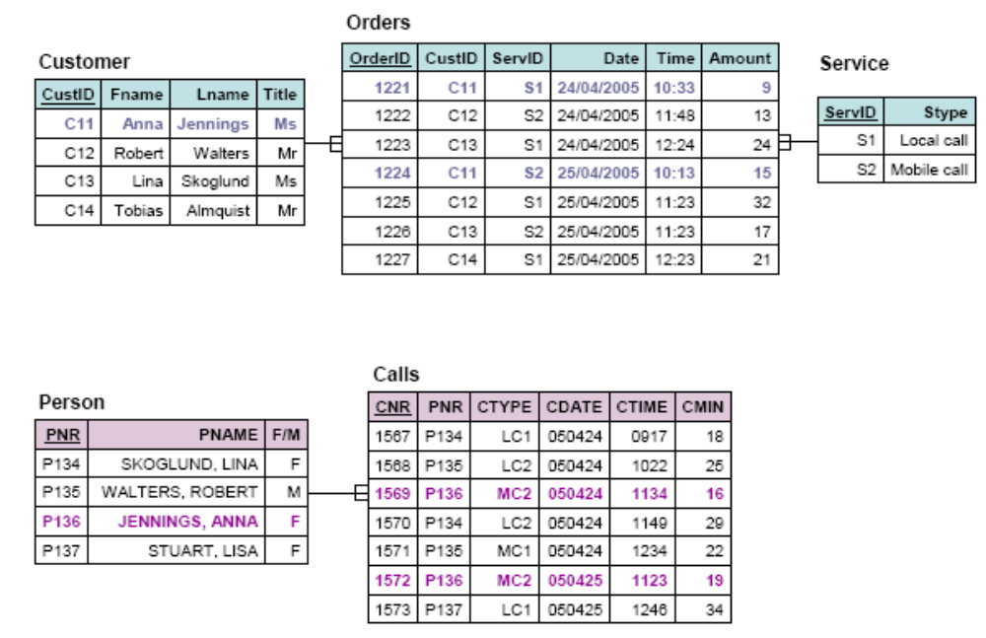
Operational sources 1,2

Slide 84
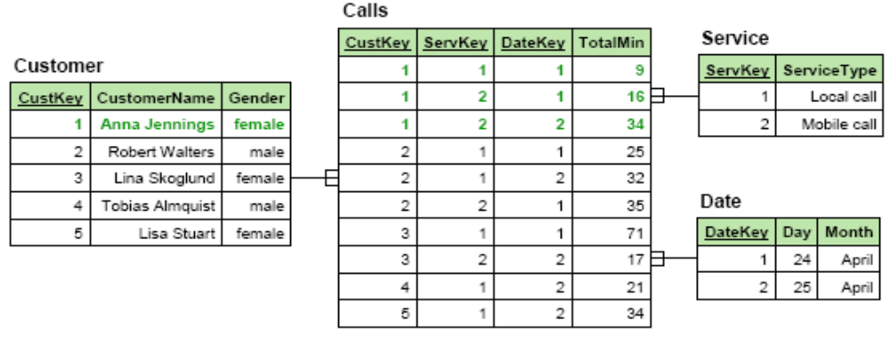
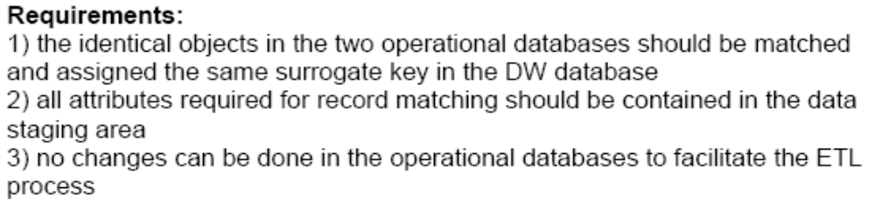
Dimensional model ex.

Slide 85
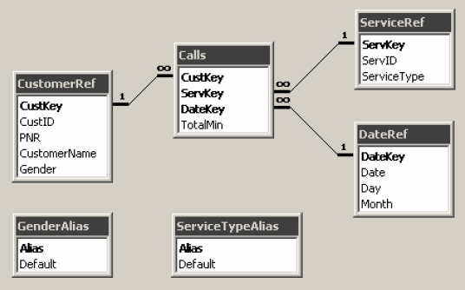
Staging area

